Slide 1
MySQL
Introduction to the MySQL products

Slide 2
MySQL
SQL/MySQL
事务，隔离，并发控制，锁
用户和权限
监控
  STATUS
索引类型：查询
  VARIABLES
备份和恢复
复制功能
集群

Slide 3
文件：
  数据冗余和不一致性
  数据访问困难
  数据孤立
  完整性问题
  原子性问题
  并发访问异常
  安全性问题
DBMS
  层次模型
  网状模型
  关系模型
RDBMS
文件：
  表示层
    文件
  逻辑层
    文件系统：存储引擎
  物理层
    元数据
    数据：数据块

Slide 4
C/S：协议(mysql)
关系型数据
  表示层：表
  逻辑层：存储引擎
  物理层：数据文件
数据存储和查询
  存储管理器
  查询管理器
应用程序
SQL用户
程序员
DBA

Slide 5
thread reuse
单进程
  多线程
    守护线程
    应用线程
      10个用户
        256M
        1G
        256M
  32bit:
    2.7G
  64bit:
    smp: 对称多处理器

Slide 7
自然连接
user.shellid=shell.shellid

Slide 8
E-R：实体-关系模型
shellid
shellid
shell
1
8

Slide 9
MySQL插件式存储引擎
  5.5.8： MyISAM
  5.5.8后: InnoDB
连接管理器
缓存
解析器
优化器

Slide 10
用户连接请求
连接管理器
线程管理器
用户模块
缓存
模块
日志
模块
命令分发模块
解析器
repair
优化
器
表定义
模块
表维护
模块
复制
模块
状态报
告模块
访问控制模块
表管理器
存储引擎

Slide 11
I/O操作：磁盘，块

Slide 12
Storage Engine: data block

Slide 14
20、4
桶

Slide 16
Agenda
Database
SQL
MySQL
Installing MySQL
Accessing MySQL
  command-line tools
  GUI tools

Slide 17
Databases and DBMS
Database
  To describe an assortment of products and systems that have included anything from a collection of files to a complex structure made up of user interfaces, data storage and access mechanisms, and client/server technologies.
  At its simplest, a database is a collection of data that is usually related in some fashion.
  Yet a database is more than simply a collection of related data. The data must be organized and classified in a structured format that is described by metadata, which is data that describes the data being stored.

Slide 18
The Relational Model
  The relational data model represents a radical departure from the rigid structures of the hierarchical and network models.
  Applications accessing a hierarchical database rely on a defined implementation of that database, and the database structure must be hard-coded into the application’s programming language. If the database changes, the application must change.
  However, a relational database is independent of the application.

Slide 19
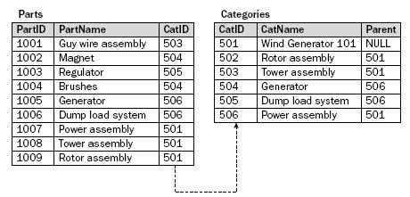

Slide 20
Database Management Systems
A DBMS is made up of a comprehensive set of server and client tools that support various administrative and data-related tasks
At the very least, a DBMS must store data and allow data to be retrieved and modified in a way that protects the data against operations that could corrupt or insert inconsistencies into the data
  Managing storage
  Maintaining security
  Maintaining metadata
  Managing transactions
  Supporting connectivity
  Optimizing performance
  Providing back-up and recovery mechanisms
  Processing requests for data retrieval and modification

Slide 21
DBA
  开发
    数据库设计
    代码设计：存储过程、存储函数、触发器
  管理
    连接管理及优化
    备份及还原
    数据库设计
    基本语句优化
    用户及权限管理
    安全管理
    数据库软件安装及升级
    配置优化

Slide 23
事务
  ACID
    Atomicity
    Consistency
    Isolation
      隔离级别
    Duration
6000
3000
5000
2500
5500

Slide 25
UNIREG, mSQL, MySQL AB
脚本语言
  解释器
    DDL
      CREATE
      DROP
    DML
      SELECT
      INSERT
      DELETE
      UPDATE

Slide 26
编程语言，脚本
What is SQL?
  SQL is, above all else, a computer language used to manage and interact with data in a relational database
  SQL works in conjunction with a RDBMS to define the structure of the database, store data in that database, manipulate the data, retrieve the data, control access to the data, and ensure the integrity of the data
  MySQL is built with C and C++. The functions that such an application performs in order to support connectivity, provide APIs, enable network access, or interact with client tools are carried out at the C and C++ programming level. The primary purpose of SQL is to allow the RDBMS to interact with the data.

Slide 27
Larry
IBM
  DBS
  DB2, 9
查询语句：
  select
  upate
  delete

Slide 28
Oracle
SQL Server
MySQL

Slide 29
脚本语言
bash, /bin/bash
select, update
SQL

Slide 30
A Brief History of SQL
After the relational model was introduced to the database development community in the early 1970s, IBM began researching ways to implement that model.
IBM’s research, referred to as the System/R project, resulted in a prototype of the first RDBMS. As part of the System/R project, IBM produced the first incarnation of a relational database language, which was known Structured English Query Language (SEQUEL).
Over the next few years, IBM updated the prototype and released SEQUEL/2, which was later renamed to SQL.

Slide 31
ANSI SQL ，RDBMS
The ANSI Standard
  By the mid-1980s, relational databases and SQL had become an industry standard
  ANSI released the first published SQL standard (SQL-86) in 1986
  ANSI updated the standard in 1989 (SQL-89) and again in 1992 (SQL-92)
    Because of the significant expansion of the standard, SQL-92 defined three levels of conformance:
      Entry: This level represented the most basic stage of conformance, and was based primarily on the SQL-89 standard, with only a few improvements.
      Intermediate: Although this level represented significant advancements to the product, it was believed that most products could achieve compliance.
      Full: A RDBMS had to be in complete compliance with the standard.

Slide 32
The ANSI Standard
  In 1999, ANSI, along with the International Organization for Standardization (ISO) published SQL:1999, the first complete update to the SQL standard since 1992
    SQL:1999 standard took a different approach to conformance levels
    To be in conformance to the new standard, a RDBMS had to be in compliance with Core SQL
  Most RDBMSs, including MySQL, conform to the Entry level of SQL-92 and achiev some conformance to Core SQL in SQL:1999
  SQL:2003, introduced some additional features compared SQL:1999, such as Extensible Markup Language (XML)

Slide 33
结构化编程
Oracle, PL/SQL
SQL Server, T-SQL
MySQL, SQL

Slide 34
4X8bit
范式
约束
  候选键
  primary key （主键）
  foreign key （外键）
  检查性约束
  unique key 惟一键

Slide 35
RDBMS
  Oracle: 9i, 10G
  SQL Server
  Sybase
  DB2
  Infomix
  MySQL
    MySQL AB → SUN → Oracle
    MariaDB
  PostgreSQL
    EnterpriseDB
      Community
      Enterprise

Slide 36
The MySQL RDBMS
MySQL is a relational database management system (RDBMS) that runs as a server providing multi-user access to a number of databases
MySQL is officially pronounced /maɪɛskjuːɛl/ ("My S-Q-L"), but is often pronounced /maɪsiːkwəl/ ("My Sequel"). It is named for original developer Michael Widenius's daughter My.
The MySQL development project has made its source code available under the terms of the GNU General Public License, as well as under a variety of proprietary agreements
MySQL is owned and sponsored by a single for-profit firm, the Swedish company MySQL AB, now owned by Sun Microsystems, a subsidiary of Oracle Corporation

Slide 37
Mont, TcX, Unireg, SQL
  Unireg, SQL
  MySQL AB
  96, MySQL, solaris

Slide 38
Speed
  完全多线程
  查询缓存
Reliability
Scalability （伸缩性）
Ease of use
Portability and Standards Compliance
Multiuser Support
Internationalization
Wide Application Support
  C, C++, Java, Perl, PHP, Python, Ruby
  JDBC, ODBC, .NET
Open Source

Slide 39
The MySQL RDBMS
The roots of MySQL server are found in a database system called Unireg that was developed by Michael ‘‘Monty’’ Widenius for a Swedish company called TcX during the 1980s
The initial release of MySQL server was created in 1995 when Monty added an SQL interface to Unireg
David and Monty, together with Allan Larsson, founded MySQL AB in 1995.

Slide 40
In 2001 MySQL began supporting transactions with the integration of the BDB and InnoDB engines
Over the years the feature set of the MySQL server has grown to cover almost any feature needed in an enterprise database server

Slide 41
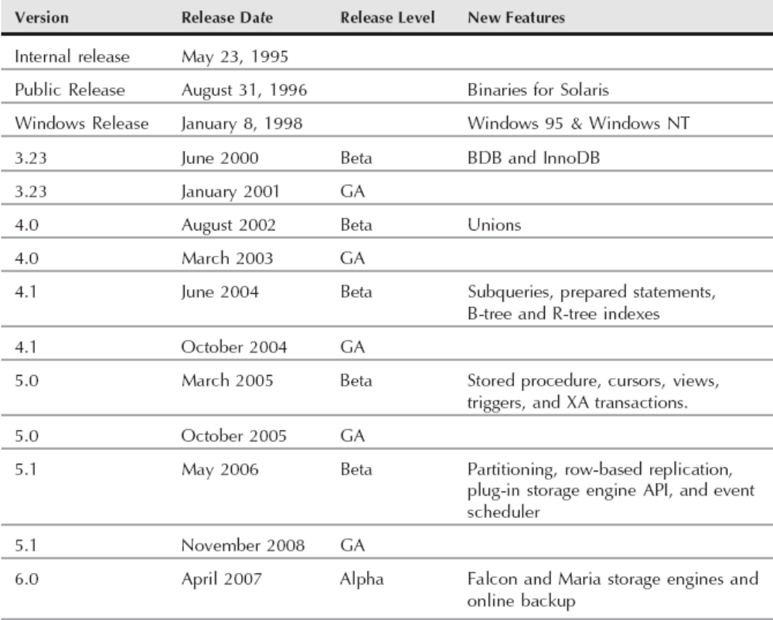
MySQL Server Timeline

Slide 42
Product family
MySQL Server (mysqld, mysql)
MySQL Cluster
MySQL Proxy
MySQL Adminitrator
MySQL Query Browser
MySQL Workbench
MySQL Migration Toolkit
MySQL Embedded Server
MySQL Drivers and Connectors

Slide 43
Community and Enterprise server versions
In August of 2007 MySQL AB began offering the MySQL server in two different versions:
  MySQL Community
  MySQL Enterprise
Contribute to MySQL server
  Blogging
  Mailing lists
  User groups
  Documentation
  Code
  MySQL Magazine

Slide 44
MySQL →
MariaDB
Percona

Slide 45
Installing and Upgrading
MySQL Server

Slide 46
MySQL’s Logical Archtecture
客户端
单进程
2.7G
多线程
连接/线程处理
线程池
查询 缓存
分析器
page:4k
10行
page:4k
10行
优化器
page:4k
10行
存储引擎
文件系统

Slide 47
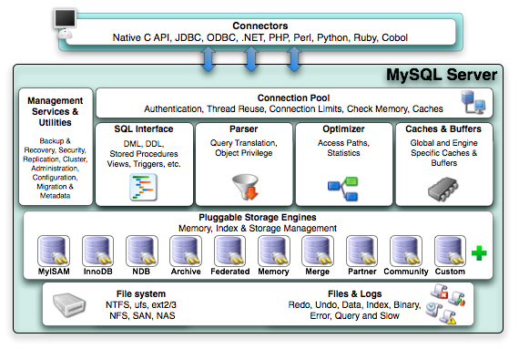
MySQL Arch

Slide 48
Before Installation
Source code installation and binary file installation?
Problems with Vendor-Supplied Packages
  Some vendor-supplied packages may not include all the features and bug fixes, because the packaging process does not necessarily include all the documented changes.
Choosing the MySQL version
  GA (General Availability)
  RC (Release Candidate)
  beta
  alpha

Slide 49
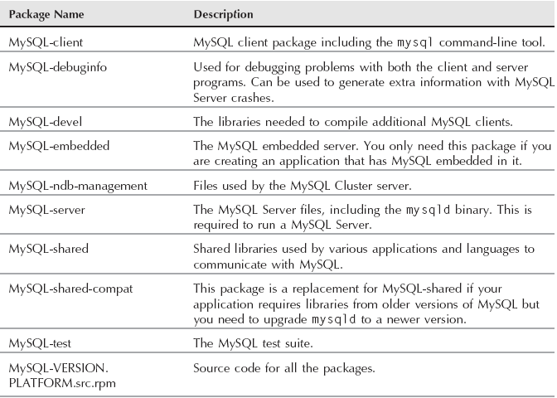
Installing from an rpm file on GNU/Linux
MySQL RPM Packages

Slide 50
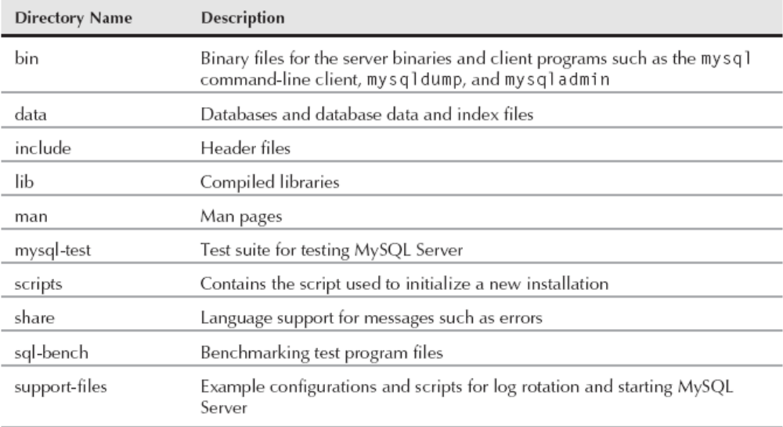
Installing from an archive package on Unix
MySQL Server Archive Package Directories

Slide 51
Initial Configuration
After installation, mysqld must be initialized and configured
Many MySQL programs, including mysqld, use a central configuration file to allow a database administrator to set various parameters that will persist across reboots
  The MySQL configuration file is used for many MySQL programs, including mysqld
  This centralized configuration file allows control of the behavior and characteristics of MySQL
  Different MySQL programs use options from different directives in the configuration file
    For example, mysqld uses options under the [mysqld] directive. Client programs such as mysql and mysqladmin use options under the [client] directive
  This configuration file is also known as an option file, because it contains options and their values

Slide 52
mysqld --defaults
On startup, mysqld looks for this configuration file in several locations
This is done in a specific order, On Unix-based systems the following order of precedence is used:
  /etc/my.cnf
  /etc/mysql/my.cnf
  $MYSQL_HOME/my.cnf
  /path/to/file when defaults-extra-file=/path/to/file is specified
  ∼/.my.cnf
Even if the server finds a configuration file in the first location it will still check each location for a configuration file
If more than one file is located, all option files are used by the server.
If more than one file has the same option, the last option read is used

Slide 53
$MYSQL_HOME refers to an operating system user environment variable.
If it is not set, MySQL programs will set it to be the same as the base directory (basedir) by default, unless there is a my.cnf file in the data directory (datadir), in which case the data directory will be used.
The defaults-extra-file is used to specify an additional location of a configuration file. It is passed as an argument when beginning start-up of the mysqld binary.
  mysqld_safe --defaults-extra-file=/etc/mysql/my_instance.cnf

Slide 54
Initial Configuration files on Windows
With Windows servers the following order of precedence is used:
  %WINDIR%\my.ini, %WINDIR%\my.cnf
  C:\my.ini, C:\my.cnf
  %INSTALLDIR%\my.ini, %INSTALLDIR%\my.cnf
  /path/to/file when defaults-extra-file=/path/to/file is specified

Slide 55
MySQL Post-Install Configuration on Unix
Setting initial passwords
  All initial accounts are created without passwords
  With Unix-based servers a total of five users are created by the mysql_install_db script
    There are three root accounts: root@127.0.0.1, root@localhost, and the root@hostname
    Two anonymous user accounts: ‘ ’@localhost and ‘ ‘@hostname

Slide 56
Root user password assignment
  # mysqladmin -u root password ’new-password’ -p
  # mysqladmin -u root -h this_host_name password ’new-password’
Another way
  You have two methods of doing this manually: executing the SET PASSWORDcommand or executing the appropriate UPDATE statement followed by a FLUSH PRIVILEGES statement
    mysql> SET PASSWORD FOR ’root’@’host_name’ = PASSWORD(’new_password’);
    OR.
    mysql> UPDATE mysql.user SET Password = PASSWORD(’new_password’)
    WHERE User = ’root’ and Host=‘mysql.a.org’;
    mysql> FLUSH PRIVILEGES;

Slide 57
Anonymous users
  Anonymous users are user accounts with a username of an empty string (’’)
  It is a best practice to drop the anonymous users because there is very rarely any valid reason to retain these accounts
  mysql> DROP USER ’’@localhost;
  To ensure that you have dropped all anonymous users, run the following query:
    mysql> SELECT user,host,password FROM mysql.user WHERE user=’’;

Slide 58
Accessing MySQL

Slide 59
mysql → mysqld
  Unix
    mysql → mysql.sock → mysqld
  Windows
    mysql → memory(pipe) → mysqld
不在同一主机上，基于TCP/IP协议
mysql
  -uroot –h172.16.100.1

Slide 60
General MySQL Architecture
MySQL operates in a networked environment using a client/server architecture
In other words, a central program acts as a server, and various client programs connect to the server to make requests
A MySQL installation has the following major components:
  MySQL Server, or mysqld, is the database server program
  Client programs
  MySQL non-client utilities

Slide 61
MySQL Server
MySQL Server, or mysqld, is the database server program
The server manages access to the actual databases on disk and in memory
MySQL Server is multi-threaded and supports many simultaneous client connections
Clients can connect via several connection protocols

Slide 62
Client programs
For communicating with the server to manipulate the information in the databases that the server manages
MySQL AB provides several client programs. The following list describes a few of them:
  MySQL Workbench and MySQL Administrator are graphical front ends to the server
  mysql is a command-line program that acts as a text-based front end for the server. It's used for issuing queries and viewing the results interactively from a terminal window
  Other command-line clients include mysqlimport for importing data files, mysqldump for making backups, mysqladmin for server administration, and mysqlcheck for checking the integrity of the database files

Slide 63
MySQL non-client utilities
These are programs that act independently of the server.
They do not operate by first establishing a connection to the server. myisamchk is an example. It performs table checking and repair operations.
Another program in this category is myisampack, which creates compressed read-only versions of MyISAM tables.
Both utilities operate by accessing MyISAM table files directly, independent of the mysqld database server.

Slide 64
Accessing mysqld with Command-Line Tools
These tools include mysql, mysqladmin, and mysqlshow
Though each tool performs different functions, they have several common options
Often these options will have a long form and a short form
Help option
  -?
  -I
  --help

Slide 65

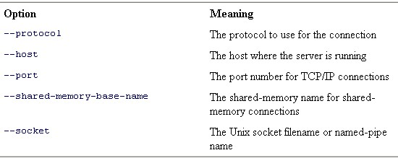
Common Options
Options for MySQL User Identification
Options for Establishing a Connection

Slide 66
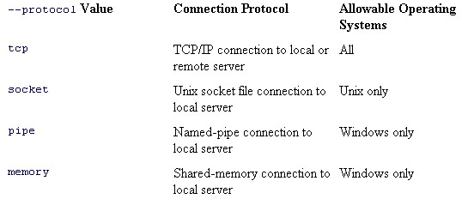
- - protocol option
The --protocol option, if given, explicitly selects the communication protocol that the client program should use for connecting to the server

Slide 67
If there are no protocol, socket, host, or port options given, a socket file will be used for connecting
If a port option is given and no host or protocol options are given, a socket file is used to connect
If the protocol specified is TCP, the connection will be made via TCP/IP even if a socket option is given
If the protocol specified is SOCKET and a port is given but no host is given, a socket file is used to connect
If the protocol specified is SOCKET and the host option localhost is given, a socket file is used to connect
If the protocol specified is SOCKET and a host option other than localhost is given, an error occurs (regardless of whether a port option is given)
If the host, port, and socket options are all given but the protocol option is not, the host and port are used

Slide 68
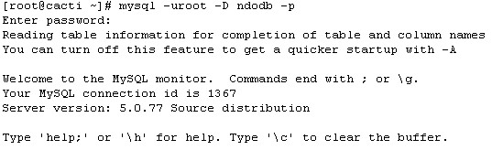
Other options
In addition to the common options, the most frequently used option to mysql is the database option
  -D db_name
  --database=db_name

Slide 69
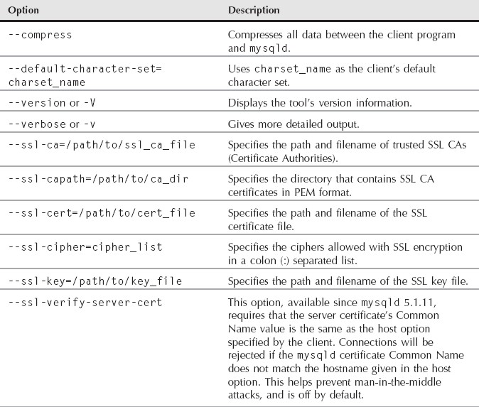
Other Common Options for Command-Line Tools

Slide 70
Set options in [client]
mysql will read options in the [client] directive of configuration files
  [client]
  database=ndodb
  user=root
  password=pass

Slide 71
Using “mysql”
The mysql client program enables you to send queries to the MySQL server and receive their results.
It can be used interactively or it can read query input from a file in batch mode:
  Interactive mode is useful for day-to-day usage, for quick one-time queries, and for testing how queries work
  Batch mode is useful for running queries that have been prewritten and stored in a file. It's especially valuable for issuing a complex series of queries that's difficult to enter manually, or queries that need to be run automatically by a job scheduler without user intervention

Slide 72


After mysql connects to the MySQL server, it prints a mysql> prompt to indicate that it's ready to accept queries
To issue a query, enter it at the prompt
Complete the query with a statement terminator (typically a semicolon)
The terminator tells mysql that the statement has been entered completely and should be executed
When mysql sees the terminator, it sends the query to the server and then retrieves and displays the result

Slide 73
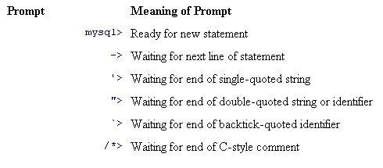
The mysql Prompts

Slide 74
Useful features of mysql
The most useful features of mysql are:
  Leave the mysql interactive shell (command only, exit, quit or \q)
  Specify the use feature to change databases within mysql, the short form is \u
  mysql keeps an in-memory list of the commands typed in the session
  Some shell interpreter keys retain their function on the mysql command line, For example:
    Ctrl-w deletes the previous word and stores it in a buffer.
    Ctrl-y retrieves (yanks) the contents of buffers filled with Ctrl-u or Ctrl-w
    Ctrl-u deletes the entire line prior to the cursor position and stores it in a buffer
    Ctrl-a moves the cursor to the beginning of the current line
    Ctrl-e moves the cursor to the end of the current line

Slide 75

  On non-Windows machines, mysql saves commands in a history file
    ∼/.mysql_history
  On non-Windows machines, mysql has a tab completion feature
  Database objects are loaded when changing to the database
    To disable the feature, using one of the following options:
      -A
      --no-auto-rehash
      --disable-auto-rehash
    To enable the feature for new objects, using one of the following commands:
      \#
      rehash

Slide 76

Cancel a query with the clear command (clear or \c)
\d or delimiter command followed by one character or word can set a new delimiter
  The default delimiter can be changed by specifying the --delimiter=new_delimiter option to mysql
  To send a command regardless of the delimiter, use \g or go
By default, output is displayed horizontally. To display output vertically, send the command using the \G or ego command

Slide 77

To change the default output display to always be vertical, specify the -E or the --vertical option to mysql
One of the most user-friendly features is the --auto-vertical-output option to mysql. This option will display output horizontally by default. If the output is wider than the width of your terminal, the display will automatically output vertically.
The values of page_program are similar to values from the PAGER operating system environment variable. They include more, less, cut, and grep

Slide 78
Output will now be paginated as when using the operating system’s more command. By default, the pager is set to the PAGER operating system environment variable. If none is set, the default is to print to stdout (the terminal window you see on your screen). To reset the pager, use the nopager or \n command, or set the pager with no value
On a non-Windows machine, you can escape to a shell and run one command by using the system or \! command

Slide 79
Using Script Files with mysql
mysql can also accept input from a file
An input file containing SQL statements to be executed is known as a "script file" or a "batch file."
A script file should be a plain text file containing statements in the same format that you would use to enter the statements interactively
In particular, each statement must end with a terminator

Slide 80
One way to process a script file is by executing it with a SOURCE command from within mysql:
  mysql> SOURCE input_file;
    Notice that there are no quotes around the name of the file
    The file must be located on the client host where you're running mysql
The other way to execute a script file is by naming it on the mysql command line. Invoke mysql and use the < input redirection operator to specify the file from which to read query input:
  # mysql db_name < input_file

Slide 81
mysql Output Formats
By default, mysql produces output in one of two formats, depending on whether you use it in interactive or batch mode
To select an output format different from either of the default formats, use these options:
  --html or -H
    Produce output in HTML format
  --xml or -X
    Produce output in XML format

Slide 82
Client Commands and SQL Statements
When you issue an SQL statement while running mysql, the program sends the statement to the MySQL server to be executed
  SELECT, INSERT, UPDATE, and DELETE are examples of this type of input
mysql also understands a number of its own commands that aren't SQL statements
  QUIT, SOURCE, STATUS and so on
A full list of mysql commands can be obtained using the HELP command

Slide 83
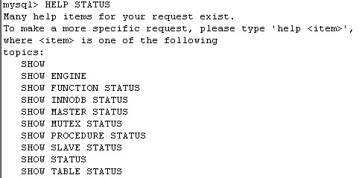
Using Server-Side Help
The mysql program can access server-side help. That is, you can perform lookups in the MySQL Reference Manual for a particular topic, right from the mysql> prompt
The general syntax for accessing server-side help is HELP keyword

Slide 84
Using the --safe-updates Option
It's possible to inadvertently issue statements that modify many rows in a table or that return extremely large result sets
The --safe-updates option helps prevent these problems. The option is particularly useful for people who are just learning to use MySQL. --safe-updates has the following effects:
  UPDATE and DELETE statements are allowed only if they include a WHERE clause that specifically identifies which records to update or delete by means of a key value, or if they include a LIMIT clause
  Output from single-table SELECT statements is restricted to no more than 1,000 rows unless the statement includes a LIMIT clause

Slide 85
mysqladmin
Used to perform administrative tasks
  Some of the tasks include creating and dropping databases, displaying server configuration, current status information, changing a password, and stopping a server. mysqladmin can be very useful in scripting situations
Systax:
mysqladmin [options] command [arg] [command [arg]] ...

Slide 86
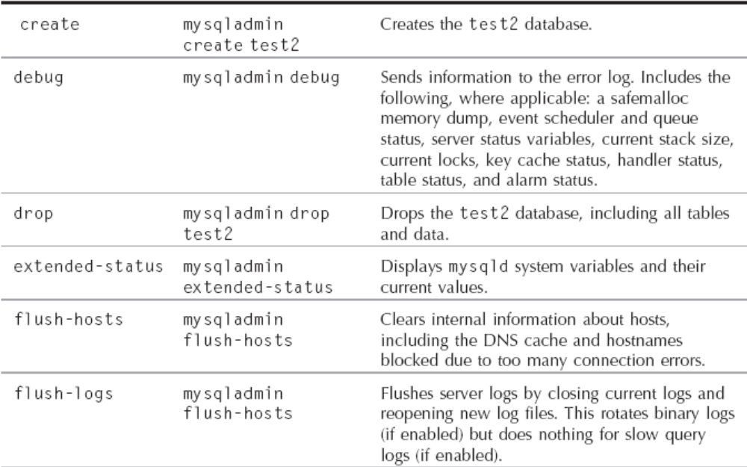
mysqladmin Command Parameters

Slide 87
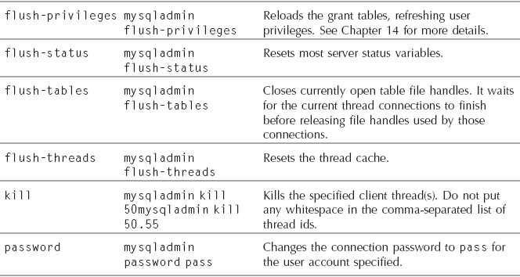

Slide 88
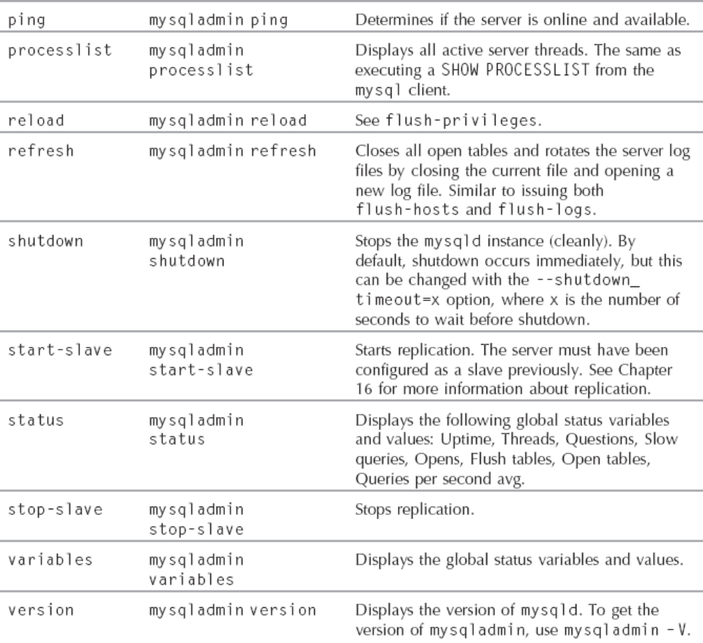

Slide 89
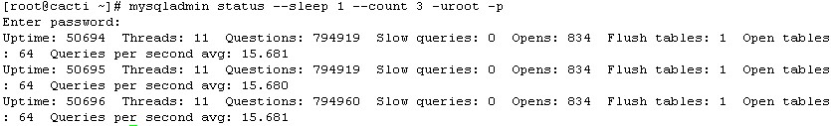
mysqladmin status
Used to return some basic information from mysqld including uptime, current number of threads, and queries per second being executed
  Can combine the status command with the --sleep option to have mysqladmin pause for the specified number of seconds and then display updated status information.
  Unless you specify the --count option (which only works in conjunction with the --sleep option)

Slide 90
GUI Tools
Navicat for mysql
SQLyog
MySQL Front
phpMyAdmin
MySQL Query Browser
MySQL Administrator
MySQL Workbench

Slide 91
SQLyog
The SQLyog program is probably the most popular GUI tool for MySQL
The program has been around since August 2002 and the maturity of the product is evident when you use the tool
For people who come from a Windows desktop background this can be a very useful and practical tool
Though it only runs on Windows desktops, there is both a free community version that is somewhat limited and an enterprise version that currently costs less than 100 USD for a single user license
  http://www.webyog.com

Slide 92
phpMyAdmin
phpMyAdmin is a free set of PHP scripts that are used to manage a MySQL server via a web interface
Because phpMyAdmin is based on these PHP scripts it does require a web server to run
Though this might be seen as a drawback, it also means that you can access your MySQL servers from any computer that has a web browser
phpMyAdmin can be used to manage an entire MySQL server or a single database

Slide 93
MySQL Query Browser
The Query Browser is a GUI tool for creating, executing, and optimizing queries.
The Query Browser includes the following components:
  Query Toolbar: Create small queries and execute them. Browse old queries
  Script Editor: Useful for editing more complex queries
  ResultsWindow: Displays query results
  Database Explorer: Navigate, create, and drop tables and fields

Slide 94
MySQL Administrator
MySQL Administrator is a GUI console that enables you to administer a mysqld server instance
Some of the functionality that MySQL Administrator allows includes:
  User management
  Monitoring database health
  Performing backups and restores
  Managing server logs
  Monitoring server connections

Slide 95
MySQL Workbench
MySQL Workbench is a visual data modeling and database design tool. Schema creation and change scripts can be automatically created from the database designs.
There are two versions of MySQL Workbench: an open source Community Edition and a commercial Standard Edition (SE)
The SE version includes enhancements for reverse and forward engineering of databases, synchronization to and from live databases, documentation, and model validation

Slide 96
MySQL Arch

Slide 97
Summary
MySQL command-line tools including:
  The mysql client
  The mysladmin tool
  The mysqlshow tool
GUI tools for MySQL administration including:
  SQLyog
  phpMyAdmin
  MySQL Query Browser
  MySQL Administrator
  MySQL Workbench

